Slide 1
Shop Management System

Slide 2


Agenda
A
Introduction
Add Items Function
Delete Items Function
View Items Function
Search Items Function
Design with GUI

Slide 3
Introduction
I would like to say that this project was created by the famous python programming language. The program deals with the shop products.

Slide 4
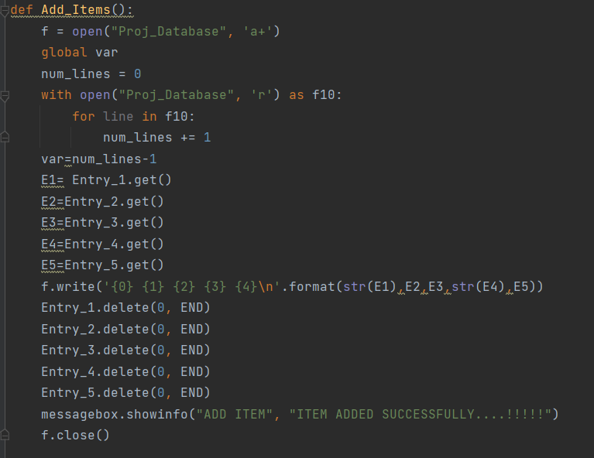
Add Items Function
First it will open “Database” file to add products in.
Then it will store data entered in Entry box in database file.
Then it will delete data in Entry Box to be able to add another product.
Finally, it will pop a message box that item is added and close Database file.

Slide 5
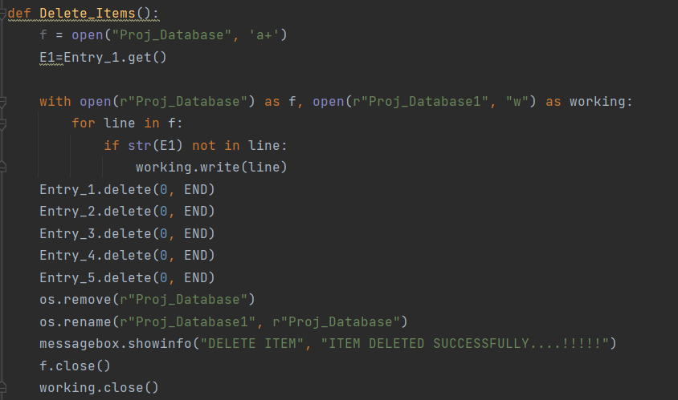
Delete Item Function
First it will open “Database” file to delete products.
Then it will take name of product you want to delete and search for.
Then it will delete line of product in Database file.
Finally, it will pop a message box that item is deleted and close Database file.

Slide 6
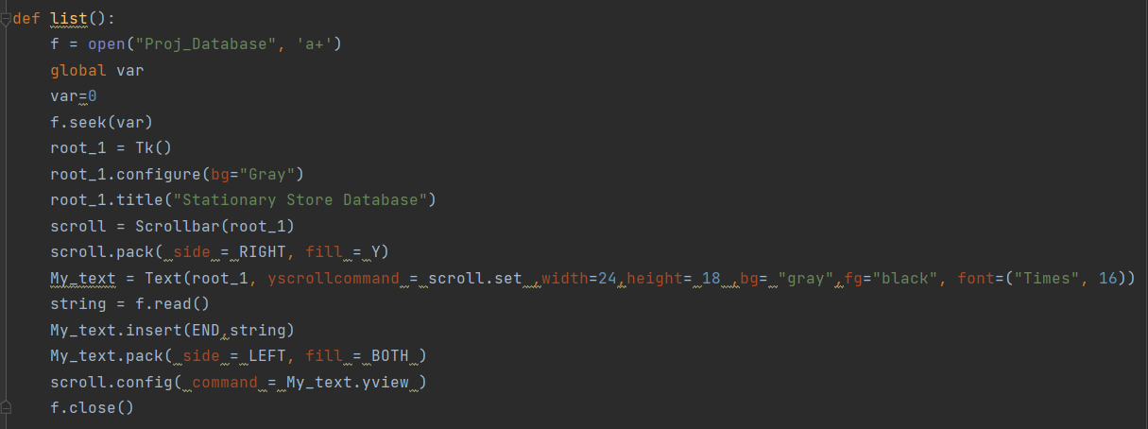
View Items Function
First it will open “Database” file to list products.
It will use GUI to view data in it.
Then it will read data from Database file and insert it in the text in configure.
Finally it will close Database file.

Slide 7
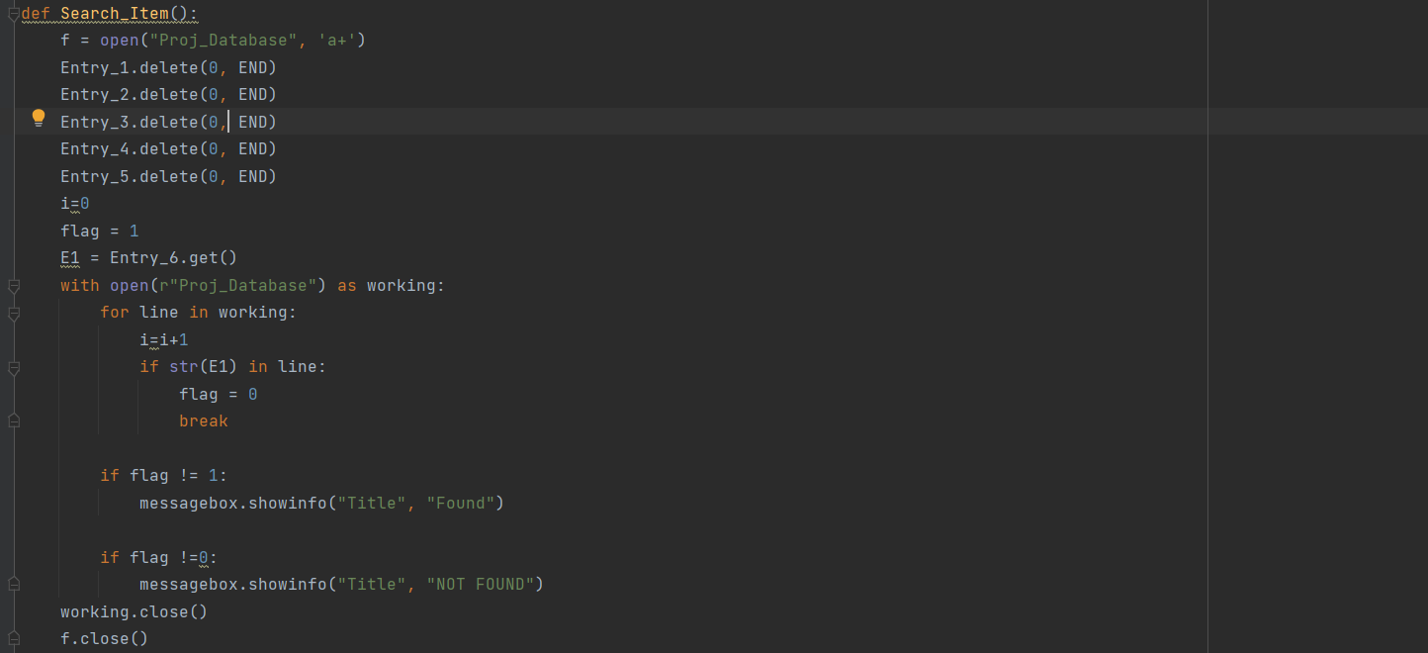
Search Item Function
First it will open “Database” file to search on products.
Then it will store string you want to search for.
Then will check if it is found using if condition and return found or not found in message box.
Finally it will close Database file.

Slide 8
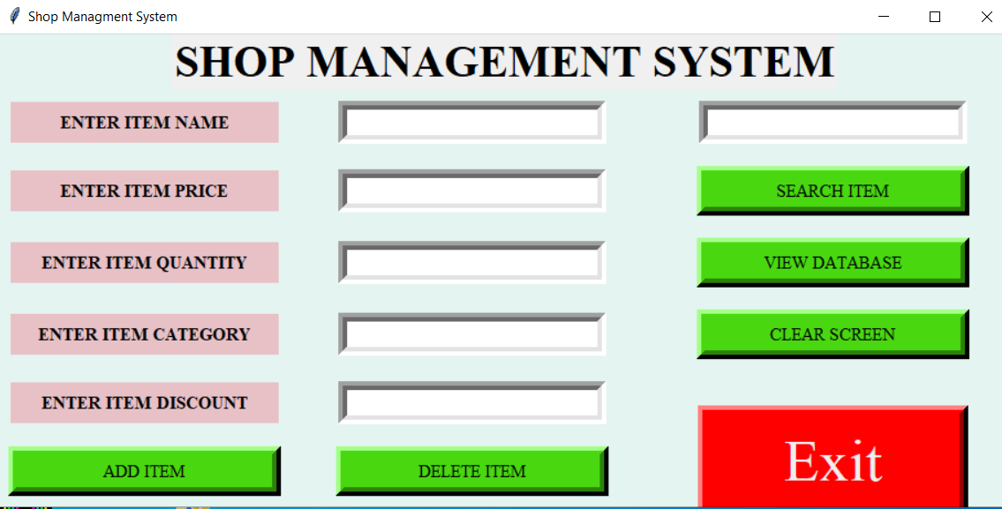
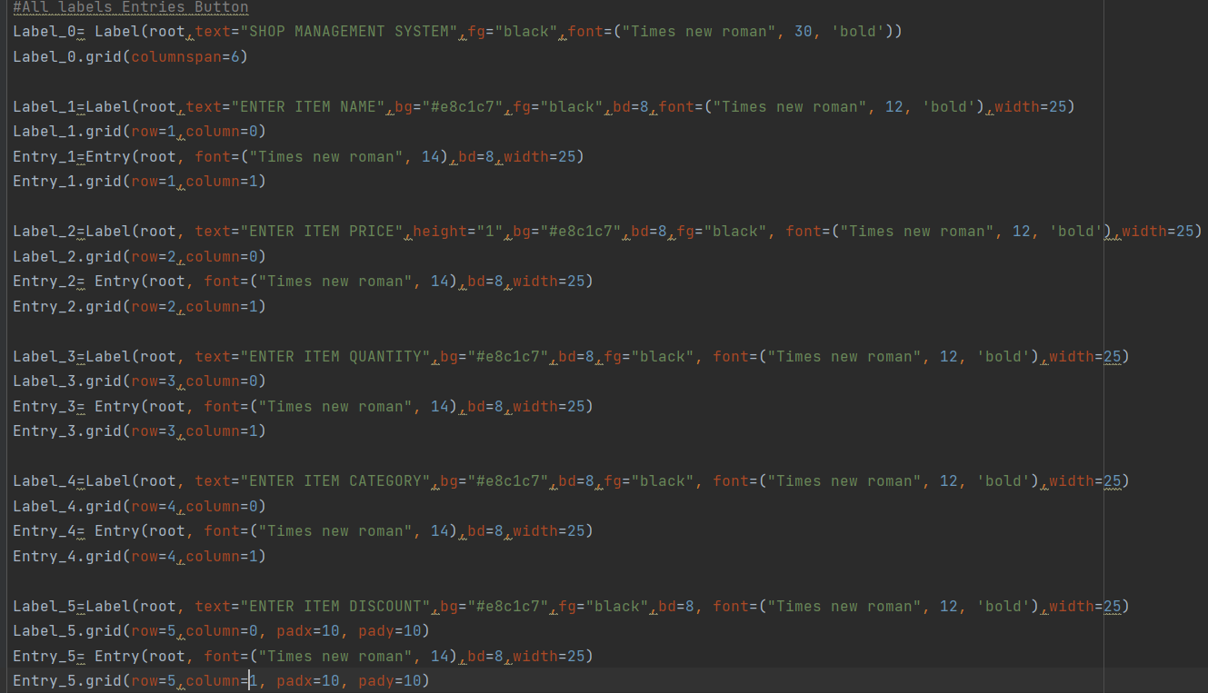
GUI
First we imported GUI library (tkinter).
Then we run configure menu (HomePage).
Then we put some labels, entries and buttons on configure menu.
Finally we took data entered in entry menu to add, view and delete using file as database.

Slide 9
Thank you

